Slide 1
Contextual Behavioral Science in Behavioral Medicine
Jennifer Gregg, Ph.D.
San Jose State University
California, US

Slide 2
Exercise
Notes:
Imagine the day when you are told that you have a disease that will likely take your life, with no real control over when or how. What feelings come up?

Slide 3
Overview/Intention
Context of medical illness
How it’s unique, how it’s the same
Types of concerns
How we conceptualize from a CBS perspective
How this might help
Buttons for therapists

Slide 4
Introductions

Slide 5
Set an Intention
Write down:
Something you feel helpless about
Something you are moving toward

Slide 6
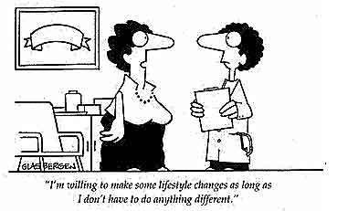

Slide 7
Setting a Context for Medical Patients
May not want a psychological intervention
Coach
Fear
Medication
Practical Tip
With patients referred by a physician not seeking a psych intervention, try starting with values first…and not necessarily health values.

Slide 8
Exercise
With a partner:
Person 1: talk about the issue you feel helpless about
Person 2: listen

Slide 9
Conceptualization
If you’ve been here all week, you probably don’t need to hear about the hexaflex
Functional Analysis
RFT
Perspective-taking

Slide 10
Functional Analysis: Context
Context: anything (current or historical) outside of the behavior being analyzed that influences the
Development
Expression
Execution
Maintenance
of the behavior
For our purposes the context includes both:
Here and now perspective
Our psychological content
Note: FA section written in collaboration
with JoAnn Dahl & Jason Lillis

Slide 11
Basic operant learning model
S^{D} – R – S^{R}
Notes:
Insert a picture illustrating a season in your country.

Slide 12
Discriminative Stimuli (S^{D})
Covert:
Sensations (5 senses) (unconditional stimuli)
Evaluation of these sensations according to our learning history (conditioned stimuli/response)
Reactions to sensations (conditioned stimuli/response) and preparation to respond
“Symptoms” in many traditions

Slide 13
Response (R)
Covert and overt responses emitted in the presence of the covert sensations
Thoughts
Feelings
Private events
Overt behaviors
“Symptoms” in ACT. Can include:
Avoidance of aversive stimuli
Problematic chasing of appetitive stimuli

Slide 14
Reinforcing stimuli (S^{R})
Function
Relief from aversive stimulation (negative reinforcement)
Obtain a desirable (positive reinforcement)
Practical Tip
Bring 2 cups into the room and label them the “moving away from” cup and the “moving toward” cup.

Slide 15
Antecedent & Consequent
Functional unit: don’t exist independently of one another
Responses can be primarily under antecedent control
Body checking
Responses can be primarily under consequential control
Exercise program
Doing what you’re “supposed to do”

Slide 16
Functional Analysis in ACT
Functional analysis involves examining the function of the response in order to change it
Often avoidance/negative reinforcement but not always
Does the behavior function to:
Gain appetitive – approach/flexibility/open
Avoid aversive – escape/rigidity/rule-bound
And how is it currently working?
Rigidity and flexibility and the present moment
Tracking vs. pliance

Slide 17
John
John

Slide 18
Do a Functional Analysis
With a partner
Revisit the issue you feel helpless about.
What are the contextual features that are important? Discriminative stimuli? Responses? Consequences?
Notes:
18

Slide 19
Perspective-Taking
Relational Frame Theory
Deictic Frames
I-HERE-NOW
YOU (NOT I)-THERE-THEN
The feared event is generally not happening right now, right here
Practical Tip
Ask:
“Is this now, or then?”
“Is this here, or there?”
“Is this you, or not you?”

Slide 20
Perspective Taking as SAC/Defusion
If it’s an
ME – HERE- NOW
Then it *needs* to be avoided
If it’s an
NOT ME – THERE – THEN
Then it can be observed, backed up from, noticed
Practical Tip
Play with physical space to defuse with perspective-taking for HERE/THERE:
Tape a thought to a knee, an elbow, a window

Slide 21
John
Sue

Slide 22
Exercise
Back to your partner:
Person 1: tell person 2’s story
Person 2: listen

Slide 23
Where Perspective-Taking gets you
What is ME – HERE – NOW?
The present
5 senses
The body
Intention
mindfulness

Slide 24
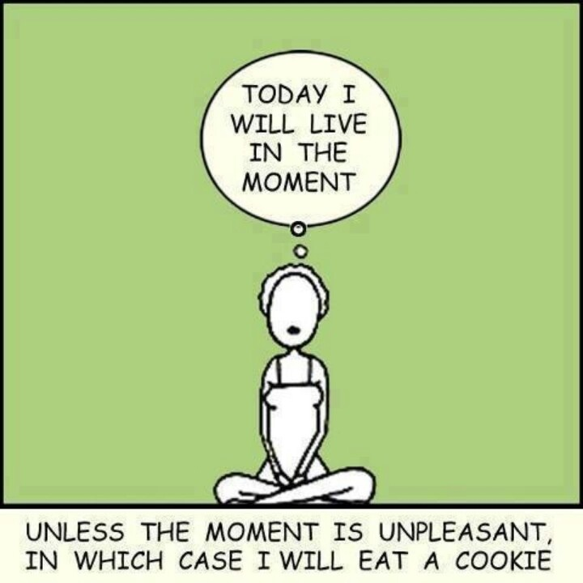

Slide 25
The Present
Right now, what is happening to you?
Is it pleasant or unpleasant?
Do you want it or not want it?

Slide 26
5 Senses

Slide 27
4 Noble Truths
Explain the nature of dukkha (“suffering” “anxiety” “dissatisfaction”)
The truth of dukkha
All humans suffer anxiety, pain, disappointment
The truth of the origin of dukkha
This suffering is caused by “thirst”
The truth of the cessation of dukkha
The truth of the path to the cessation of dukkha

Slide 28
Our Dukkha
Notice that there is an ideal version of your life that you can imagine, that doesn’t involve *this* suffering
Notice that you can compare your current life to that ideal version and find this one coming up lacking
Notice that this is always going to be the case
Notice this present, and all of those thoughts and feeling you have, which are not ME-HERE-NOW

Slide 29
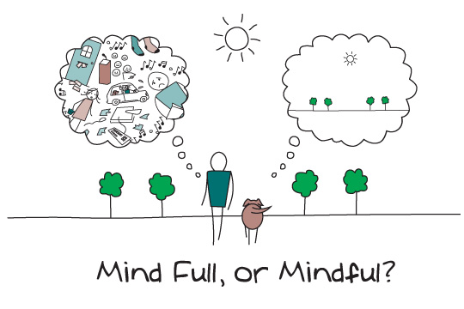

Slide 30
Values
The values that go when you’re sick, scared, dying
contribution
thoughtfulness
Helping
Thinking about the values that you have about the end of your life

Slide 31
Your Line
______________________________________________
Where are:
Partners starting and ending
Jobs starting and ending
Kids
Grandkids
Adventures
Fun

Slide 32
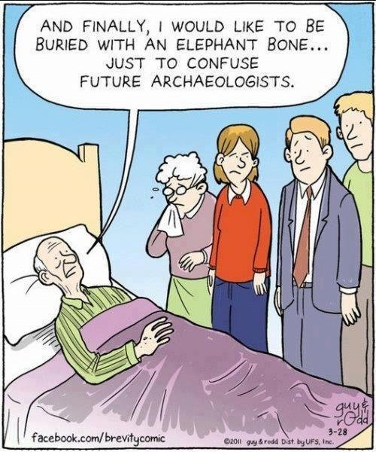

Slide 33
Your Death
Rank the following:
Get hit by a bus, with pain
Get hit by a bus, without pain
Die from a long, painful illness at home
Die from a short illness (a few days) in the hospital
Die in my sleep, without pain or warning
Have a short but scary heart attack

Slide 34
Intention = Values
This is the part we control
This is consequential, appetitive control
This is ME – HERE – NOW
This is not about getting better

Slide 35
Exercise

